Slide 1



PACTree: A High Performance Persistent Range Index Using PAC Guidelines
Wook-Hee Kim R. Madhava Krishnan Xinwei Fu Sanidhya Kashyap† Changwoo Min Virginia Tech †EPFL
Presenters: Nikhil Chhadikar, Priyanka Bhamare

Slide 2

Index
Introduction
PAC Guidelines
PACTree
Evaluations
Conclusion

Slide 3
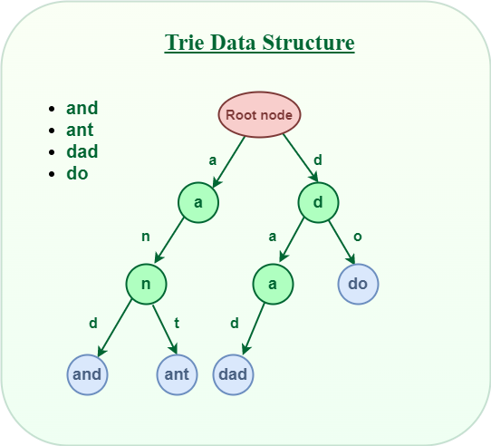
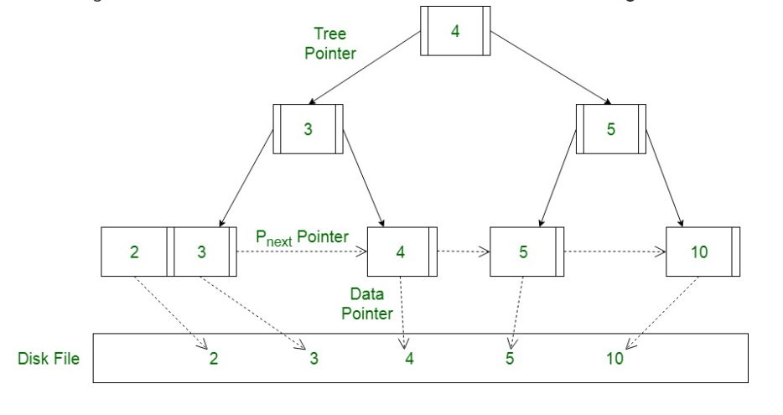
Introduction to index Structures
What are index structures?
Types of index Structures
B- Trees
Hash Indexes
Trie Indexes
B+ Tree

Slide 4
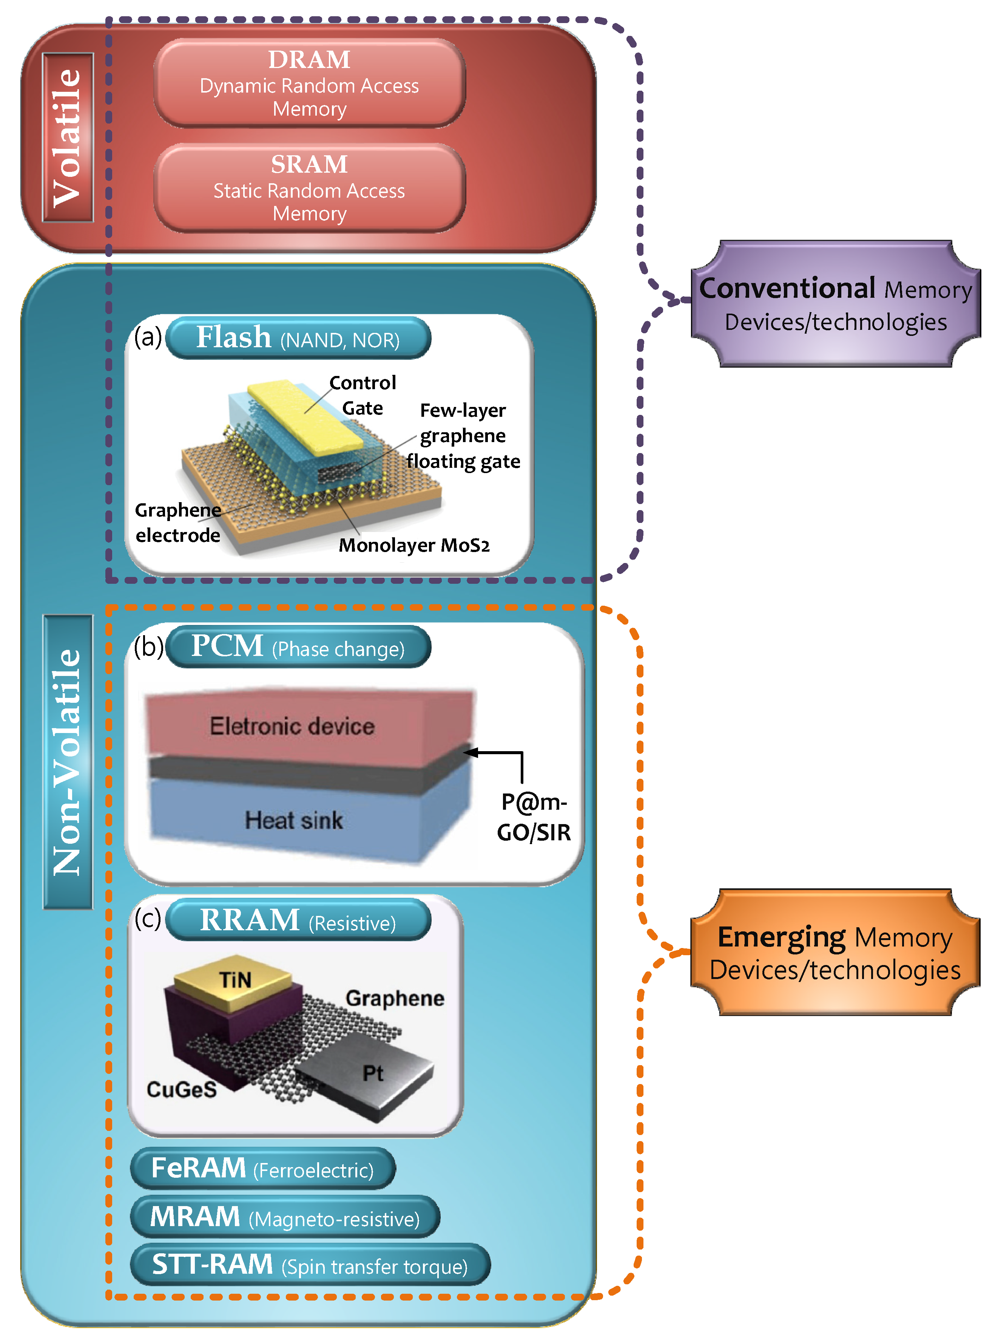
What is Non-Volatile Memory (NVM)?
Non-volatile memory (NVM) is a type of computer memory that retains stored data even when the power is turned off.
Provides fast and byte-addressable persistence.
Common examples of non-volatile memory include flash memory, which is commonly used in solid-state drives (SSDs) and USB flash drives, and read-only memory (ROM).

Slide 5
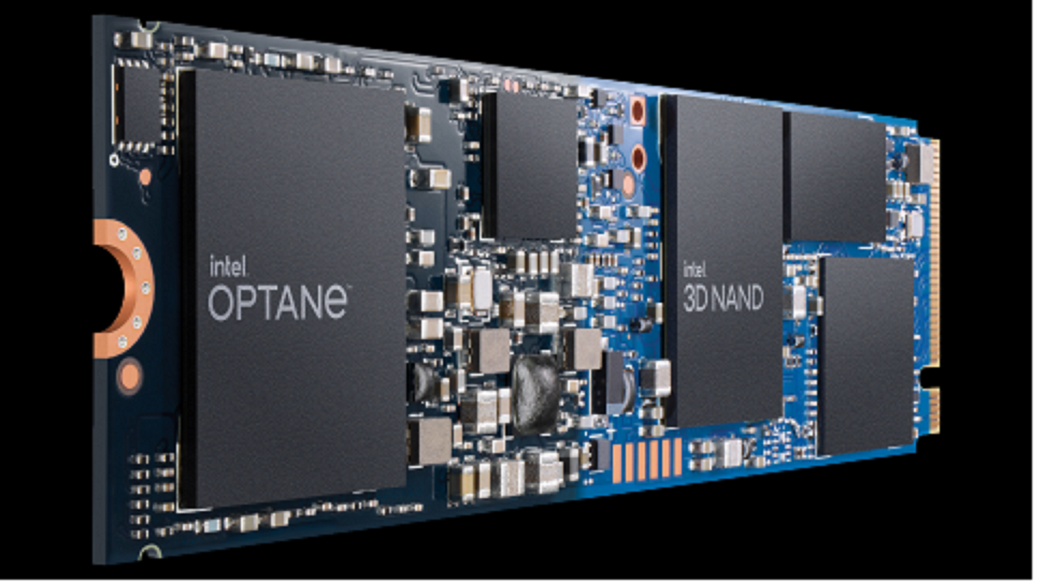
Intel’s Optane DC Persistent Memory
Non-volatile memory technology designed to provide a high-capacity and low-latency memory solution for data centers and enterprise servers.
It has a capacity up to 1TB, read and write speeds up to 2.5GB/s and 1.5GB/s respectively, and a high endurance rating with typical power consumption of only 15W for the 1TB module.

Slide 6
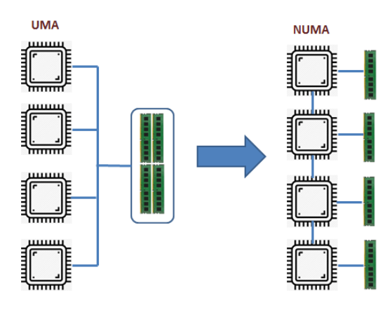
What is NUMA?
In Uniform Memory Access (UMA), all processors have equal access to all memory.
Non-Uniform Memory Access (NUMA) is a computer memory architecture that is used in multi-node systems, where each node has its own memory and processor.
NUMA is used to provide high performance and scalability in large-scale systems, such as servers and high-performance computing systems.

Slide 7

Analysis
Persistent range indexes
FastFair
BzTree
FP-Tree
PDL-ART.
Performance Limiting factors of NVM index
Limited bandwidth
High latency
Proposition
Access data in a packed fashion to save the limited NVM bandwidth
Exploit asynchronous concurrency control to decouple the long NVM latency from the critical path.

Slide 8

PAC Guidelines
Packed
Asynchronous
Concurrency

Slide 9
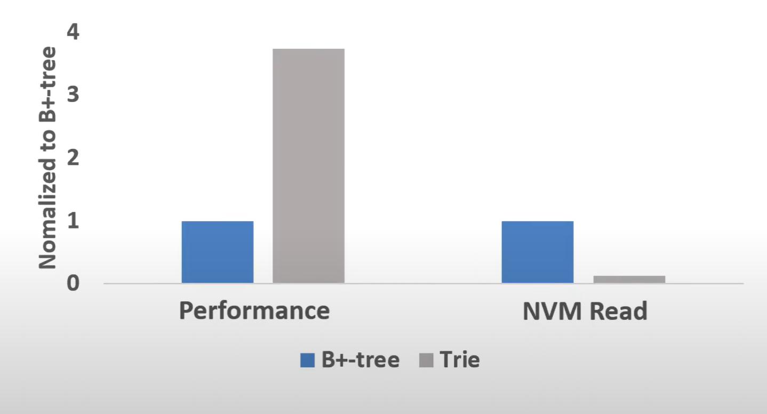

Lookup operation should consume minimal NVM bandwidth
Finding ‘AAC’
3 Bytes
B+ -Tree
AAD
3 Bytes
AAC
BCA
…
3 Bytes
AAA
AAC
AAD
Total = 9 bytes
Trie
2 Bytes
A A B
2 Bytes
A C D
C
…
Total = 4 bytes
A

Slide 10
Scan operation should maximize sequential read to NVM
The scan operation should be designed to access the NVM data in a contiguous manner to maximize sequential read performance in a non-volatile memory (NVM) system, allowing for a continuous and uninterrupted flow of data to be read into the system.

Slide 11
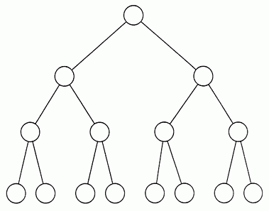

PAC Tree
Search Layer
Data Layer
A persistent and hybrid range index consisting of Trie-based internal nodes (search layer) and B+ tree style leaf nodes (data layer).

Slide 12
Search Layer
Search layer indexes anchor keys for every data node
Stores partial keys only
Consumes less space
Partial key comparison while traversing internal nodes
Search Layer
Data Layer

Slide 13
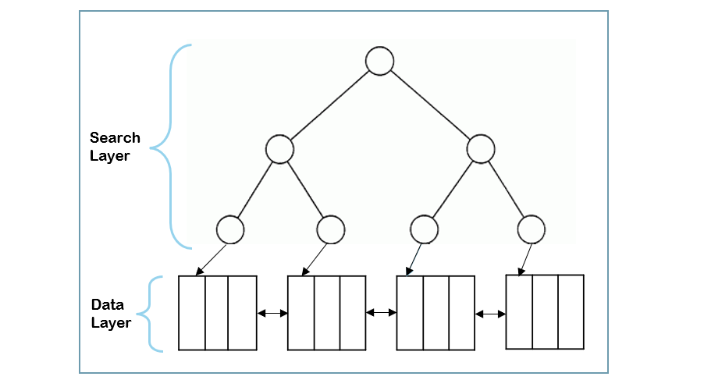
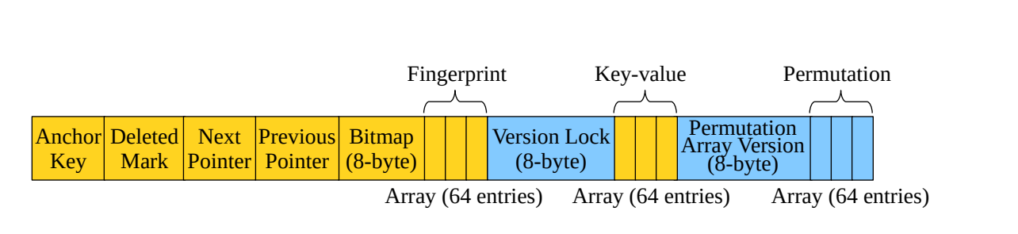
Data Layer
The data layer is a doubly linked list of nodes.
It maintains an unsorted key-value pairs, a fingerprint array for fast lookup, a permutation array for the fast scan, and an 8-byte bitmap for marking the validity of a key-value slot.
Each node has an 8-byte version lock with a 4-byte generation ID and a 4-byte version number.
We set the number of entries to 64 on purpose for several reasons:
(1) aligning the fingerprint and permutation array to a cache line
(2) atomically updating an 8-byte (64-bit) bitmap representing all entries in a node
(3) accelerating the 64-byte fingerprint matching using a single SIMD instruction.

Slide 14

Operations
Lookup & Scan
Insert & Update
Split and Merge

Slide 15
Scan & Lookup
Search for element ‘ABA’
A < ABA < B
Jump Node
A
B
AAA < ABA < ACA
AA
CA
AB
BB
A A A
A A B
A B A
A C A
ACC
B A B
B A C
B B B
B B C
Target Node

Slide 16


Insert & Update
Insert element ‘ABB’
A < ABB < B
A
B
AAA < ABB < ACA
AA
CA
AB
BB
Split & Merge
A A A
A A B
A B A
A C A
ACC
B A B
B A C
B B B
B B C
A B B
ABA < ABB < ACA

Slide 17
Asynchronous Update: Inconsistency Tolerance
Find element ‘ABB’
A < ABB < B
A
B
AAA < ABB < ACA
AA
CA
AB
BB
A A A
A A B
A C A
ACC
B A B
B A C
B B B
B B C
Jump Node
A B A
A B B
Target Node
ABA < ABB < ACA

Slide 18

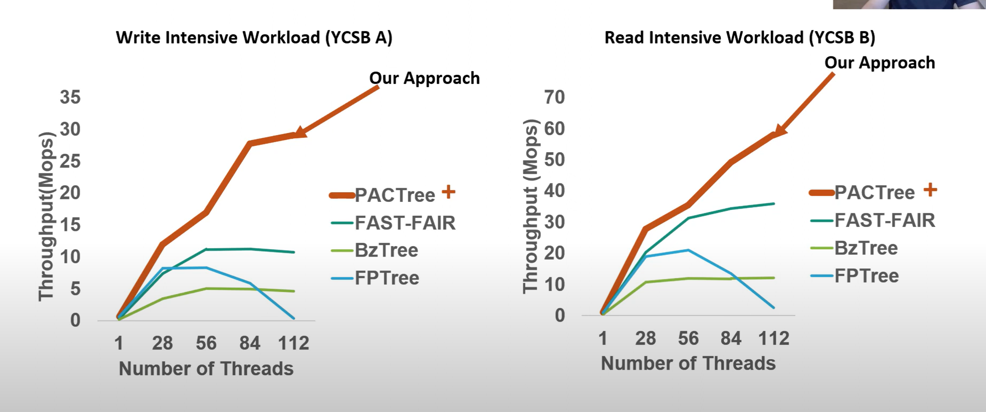
Evaluations : YCSB

Slide 19
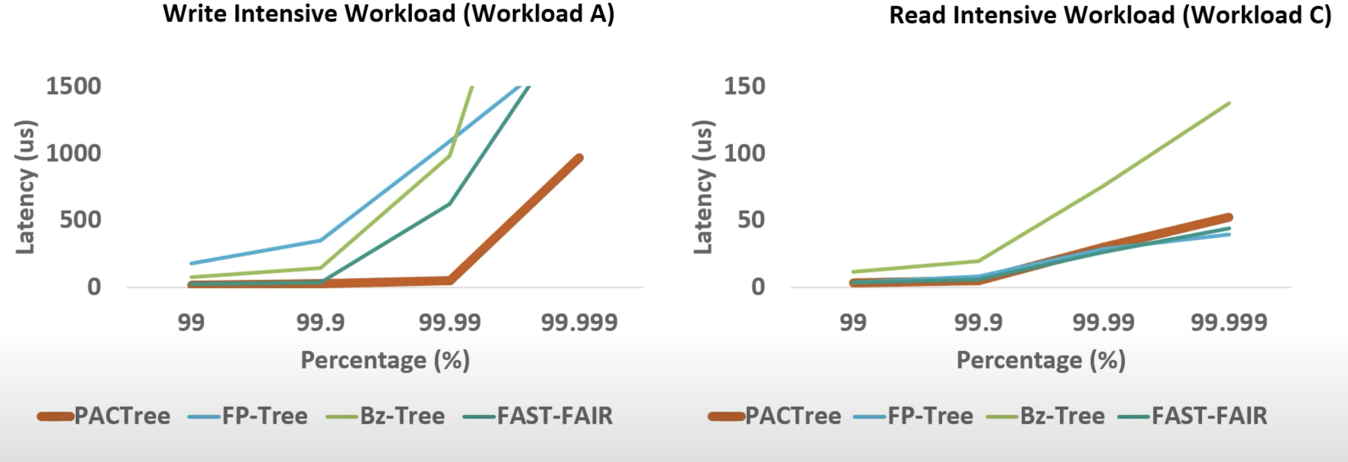
Evaluations : Latency

Slide 20

CONCLUSION
PAC guideline: design guidelines for persistent index
Access should be done in a packed fashion to save the limited NVM bandwidth.
Exploit asynchronous concurrency control to decouple the long NVM latency from the critical path.
PACTree: high-performance persistent index designed under the PAC guideline
Packed Access to NVM using Trie-based Search Layer.
Asynchronous update for Search Layer and Data Layer.
PAC guidelines can be applied to other NVM software design
Performance critical system software (e.g., File systems, Database systems).
In-memory storage systems that use NVM as large volatile memory.

Slide 21
References
https://multics69.github.io/pages/pubs/pactree-kim-sosp21.pdf
Wikipedia.com
Youtube.com
https://www.geeksforgeeks.org/
https://www.techplayon.com

Slide 22


Thank you

